Slide 1
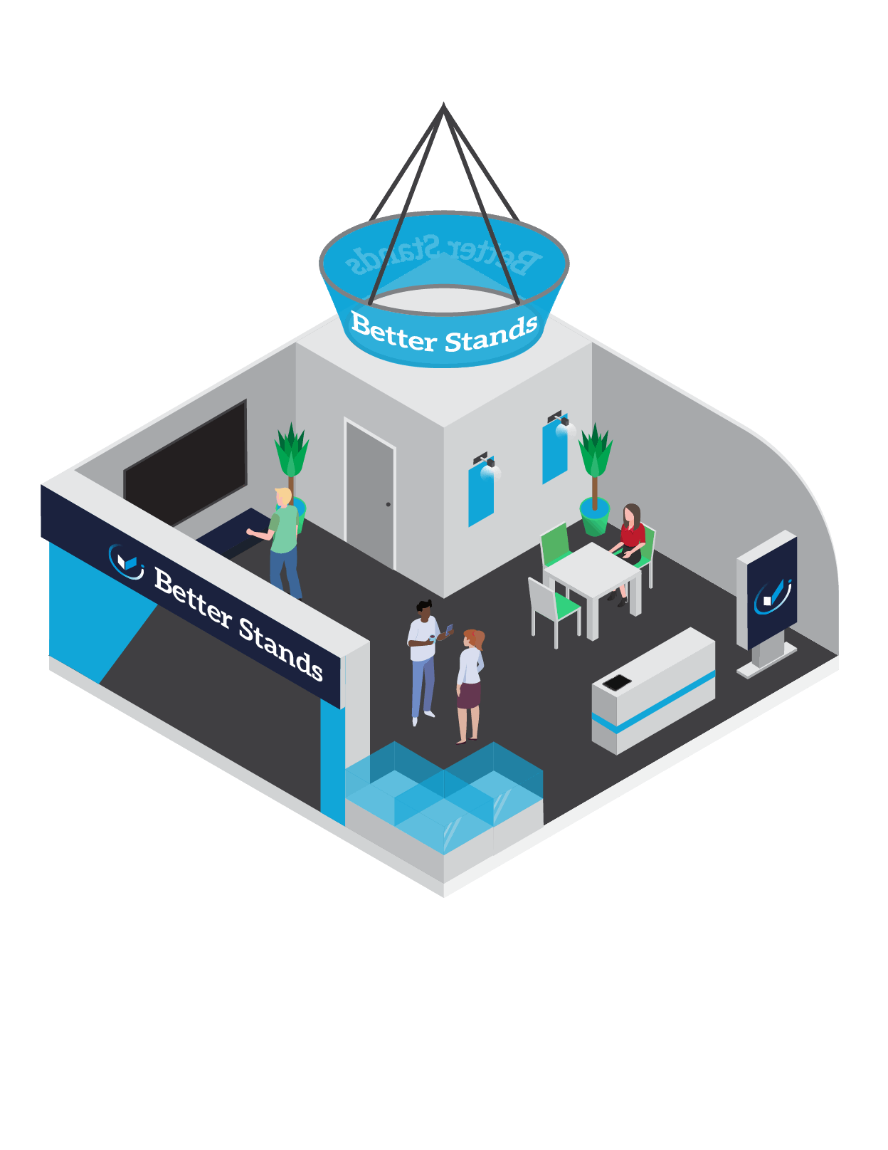
Better Stands
Procurement Guide for Exhibitors

Slide 2
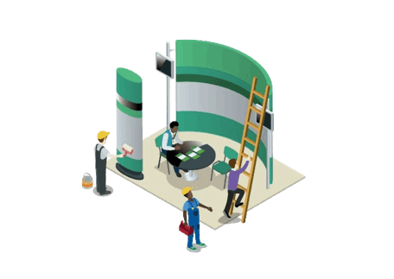
What does this quick guide cover?
How to get started
1
Renting or purchasing your stand
2
Key questions to ask your contractor
3
About Better Stands
4
What’s in it for me?
What do I need to do?
What are the guidelines?

Slide 3
Introduction to the guide
This guide is aimed at exhibitors who have elected to purchase a space only/ raw space stand for an upcoming Informa event. With so many stand contractors to choose from, it is not always easy to know which is the right one to design and build your exhibition stand.
It is important to understand all the various processes and costs that are involved in delivering a stand at a show and this understanding will give you a better idea of which contractor best suits your needs. Some research will be necessary to find the right contractor for your needs but this guide we hope will provide you with hints and tips on how to procure an exhibition stand contractor.

Slide 4
How to get started?
Details you will need to hand when briefing your contractor:
Dimensions of the stand you booked
The number of open sides and orientation of stand
A copy of the event floor plan
A copy of the event regulations - pay particular attention to rules on height limits, walling regulations for open sides and prohibited materials
The budget for your stand - does this include all services including electricity, lighting, graphics, or just the stand build itself?

Slide 5
Determine if you wish to rent your stand or purchase it
Purchasing a stand means you must consider storage costs between events. Purchasing can be cost effective if you plan to exhibit at multiple events a year. It also ensures your stand is reused.
N.B. there are lots of stands that can be built into multiple configurations using the same system so reuse does not have to mean using the same design over and over. Think of Lego but for stand design.
Rental means you put the emphasis on the contractor to design a stand to fit your needs but with reusable components that they can then utilise with other clients. Many contractors have modular rebuild stand systems, that you can provide your own graphics and brand to for the duration of the event.

Slide 6
Key questions to ask your contractor:

Slide 7
Is every stage and service in the process carried out in-house?
Check to see that all work is undertaken directly by the contractor and they do not sub-contract any elements out. If work is sub-contracted then you do not know who will be designing, printing, manufacturing or building your stand.
The use of sub-contractors can impact on the price quoted as it may appear lower initially, but additional charges could be included later. Make sure you know exactly what is included in the cost and read the small print for extras. Also, a low price can also mean the use of prohibited materials and ultimately a poor-quality finish to the stand.
What companies have they worked for previously and are they in demand?
Ask to see examples of stands they have designed and installed for previous customers. Testimonials and reviews on quality, finish, customer service, time management and budget control give good indications of how reputable a contractor is and you should always check independent review sites for these such as Trust Pilot.
There should be evidence of a steady flow of projects for new and existing customers and you should check for variety and uniqueness in designs to ensure that stands are always customised to suit individual client needs.

Slide 8
What are their sustainability and environmental credentials?
When deciding on a stand contractor you should select one that can offer a versatile selection of reusable stands options. Reusable stands are better for reducing your own waste and therefore your environmental impact. They also reduce health and safety risks, have smoother, more efficient construction and dismantling phases, promote higher quality look and feel stands and are usually cost saving. A reusable stand will also promote your brand in a positive light by highlighting your sustainability credentials. Informa launched the Better Stands campaign, is the contract familiar with this campaign, as that will lead to a more sustainable solution.
How to manage costs?
To achieve maximum return on investment, planning and budgeting are essential. Otherwise it can quickly become an expensive lesson in the importance of research and preparation. The below factors should be carefully considered:
Fix your budget and communicate this honestly to your contractor
Alongside the proposed design, request a detailed quote with full itemised cost breakdown
Items listed should include (where relevant) design, build, audio visual, electrics, flooring, furniture, graphics, internet, labour, lighting, permits, rigging, transportation, water and waste and any other special features requested
Be clear on which items are purchased and which are hired

Slide 9
Where are they located?
Regardless of where the exhibition takes place, it’s always best to hire a local contractor to the venue. This will have a huge impact on your overall spend, as logistics can be costly. The greater the distance your stand needs to be transported the higher your costs will be, not to mention other factors you may need to contend with such as delayed deliveries due to road conditions, higher carbon footprint and so on.

Slide 10
Better Stands
Programme

Slide 11
What is Better Stands?
Disposable stands are designed to be used only once, they have a significant impact on the environment, in addition to increasing health and safety risks onsite.
Better Stands is an Informa programme aiming to ensure that all core elements of exhibitor stands are reusable. Help us to reduce the environmental impact of the events by committing to the Better Stands guidelines and show that your company values being part of sustainable and socially responsible events.
What’s in it for me?
A better quality, more attractive stand
Promote the sustainable credentials of your brand
Smoother, more efficient build up and breakdown periods
Lower work hours and reduced construction costs
Lower waste bills

Slide 12
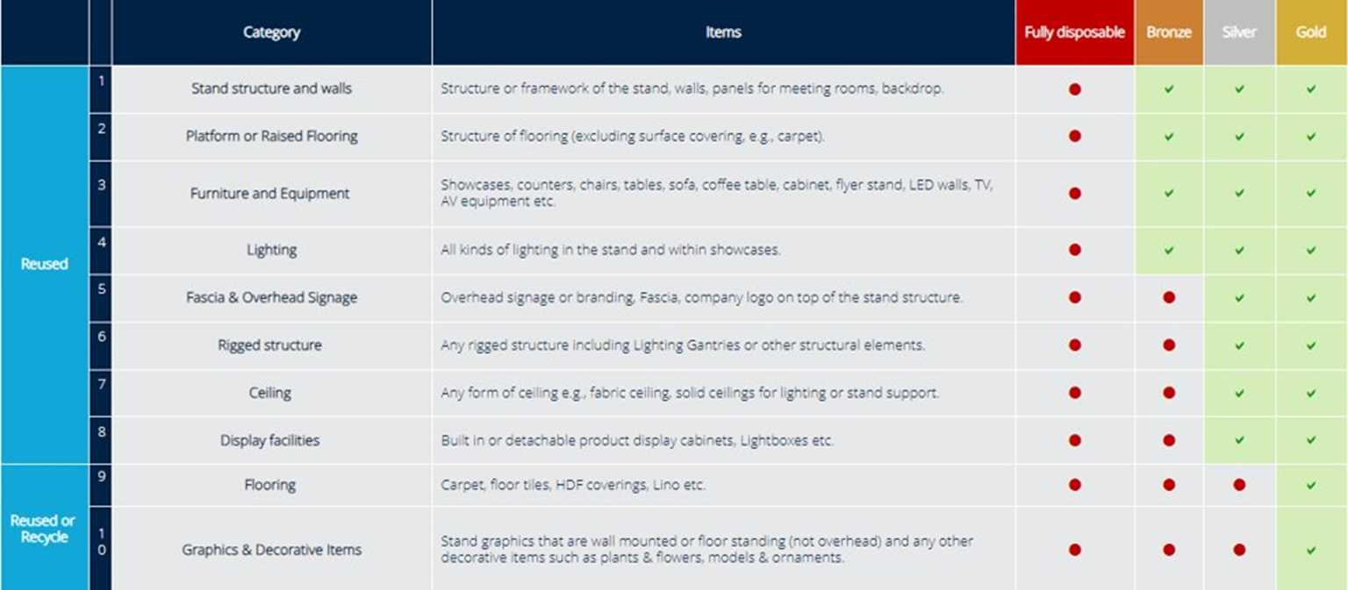
What do I need to do?
To make your commitment to Better Stands and contribute to a more sustainable event:
Read the Better Stands framework below
Ensure your stand reaches at least a bronze level, meaning the stand structure and walls, platform, furniture, equipment and lighting are all reused
Share these guidelines with your contractor before they begin designing your stand
Ensure that the submitted stand design clearly communicates how you will meet the Better Stands guidelines

Slide 13
Find out more
For more information and guidance on Better Stands consult your event’s Exhibitor Manual.
Interested in hearing more about Informa’s sustainability strategy? Please see the Informa Group Sustainability page.
We would love to hear your feedback or suggestions.
Please don’t hesitate to contact us at betterstands@informa.com

